Slide 1
EDA ON GLOBAL TERROSRISM
File created on: 4/11/2024 1:59:55 PM

Slide 2
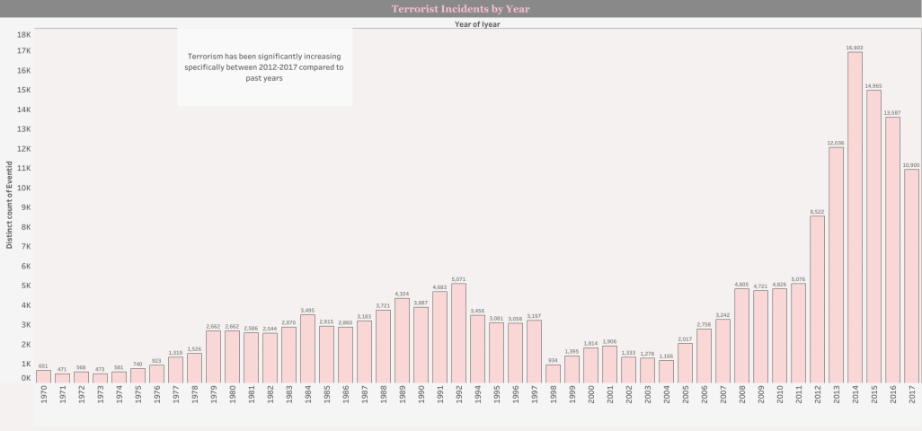

Slide 3
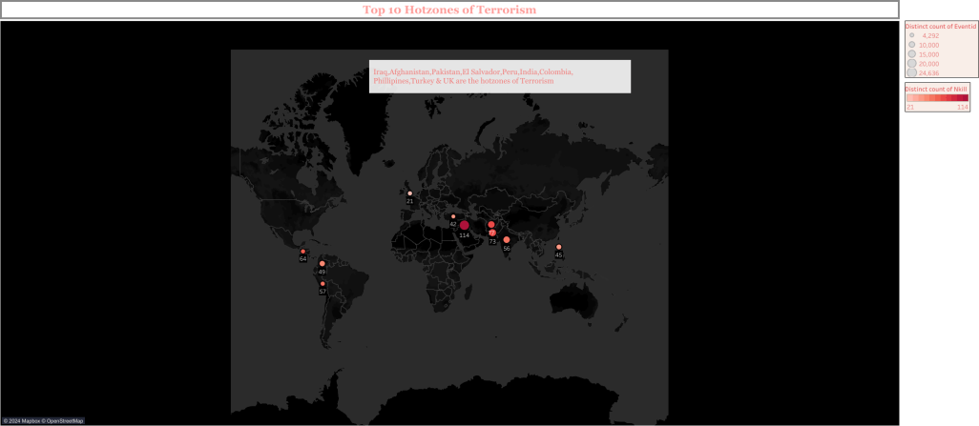

Slide 4
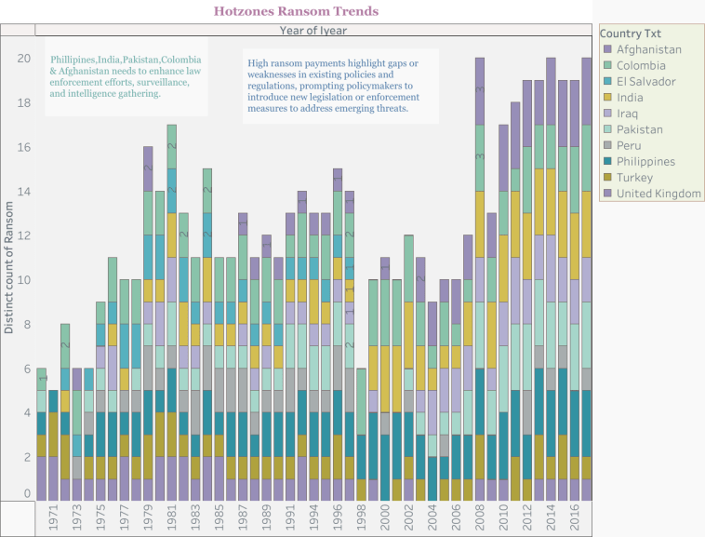

Slide 5
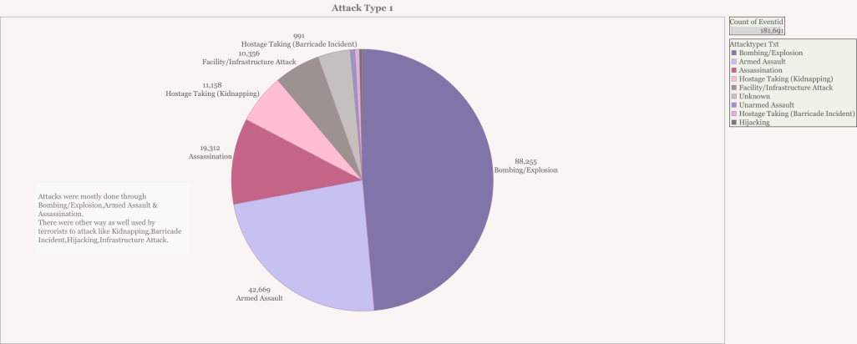

Slide 6
